Slide 1
Search and Recover Photograph Evidence

Slide 2
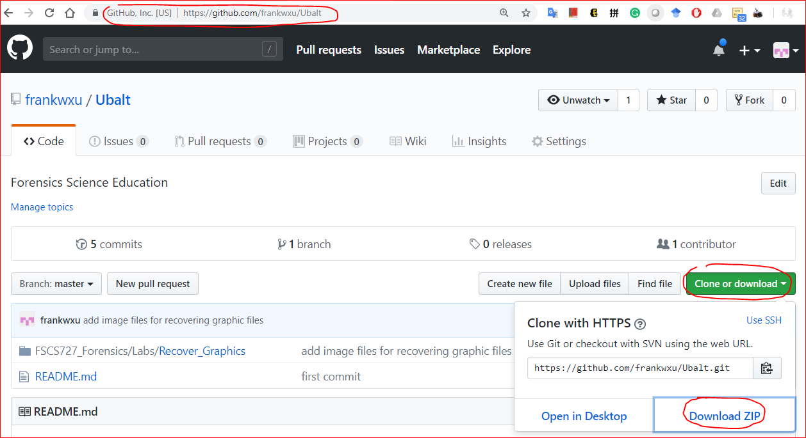
Download lab data

Slide 3
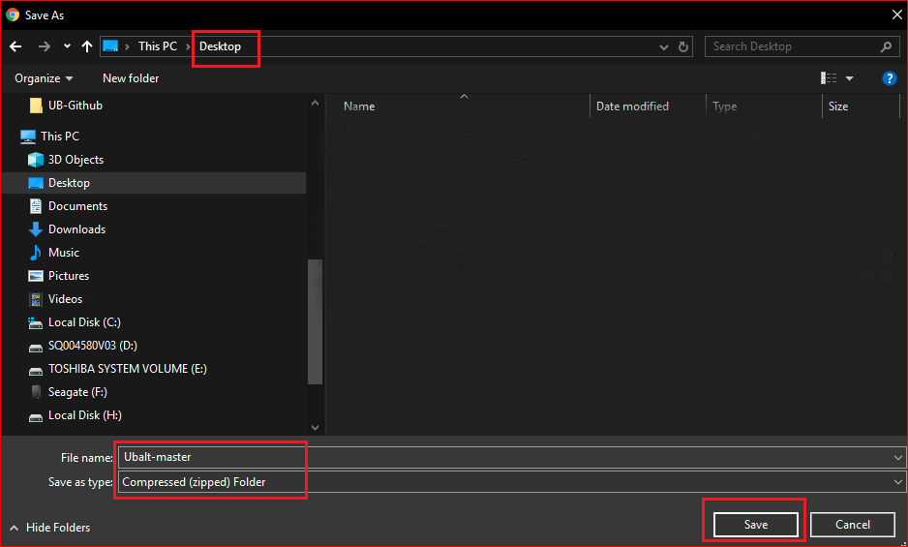

Slide 4
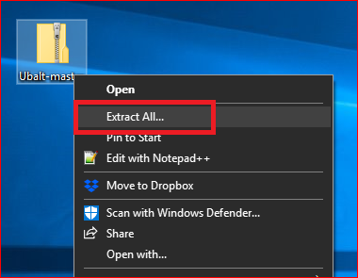
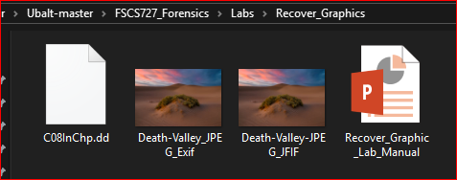
https://www.cengage.com/c/guide-to-computer-forensics-and-investigations-6e-nelson/9781337568944

Slide 5
Understanding Graphics File Formats

Slide 6
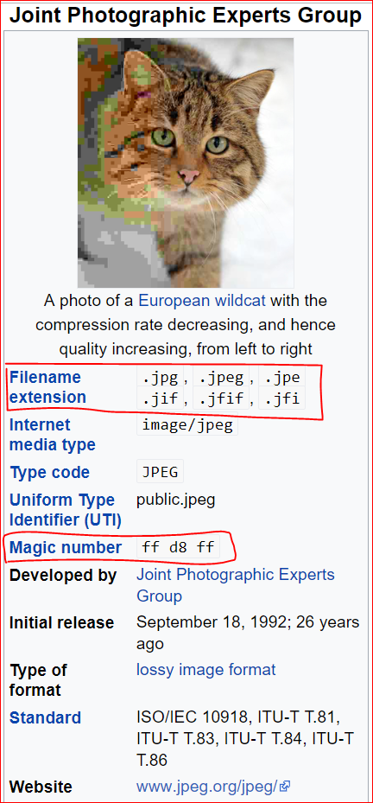
JPGE-Joint Photographic Experts Group
the name of the committee
is a commonly standard used method of lossy compression for digital photography.
only to a class of compression algorithms,
not to a specific file format.

Slide 7
The most common image file formats
JPEG/Exif (0xFFD8 FFE1)
Exchangeable Image File
Used by digital cameras and other photographic image capture devices.
Device info: Model, maker, serial number
Setting: shutter speed, focal length, resolution, date, time
JPEG/JFIF (0xFFD8 FFE0)
JPEG File Interchange Format
Storing and transmitting photographic images on the World Wide Web.

Slide 8
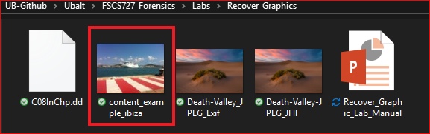
Try yourself
https://www.pic2map.com/
https://exposingtheinvisible.org/resources/image-digging

Slide 9
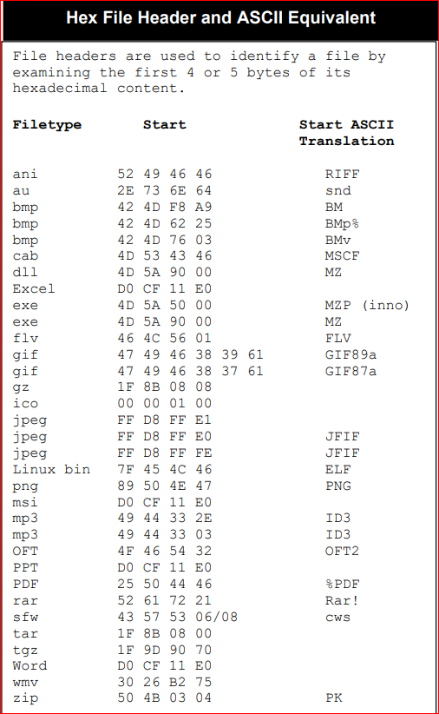
Magic numbers (file signatures)
https://digital-forensics.sans.org/media/hex_file_and_regex_cheat_sheet.pdf
http://technologieshare.com/what-is-exif-data

Slide 10
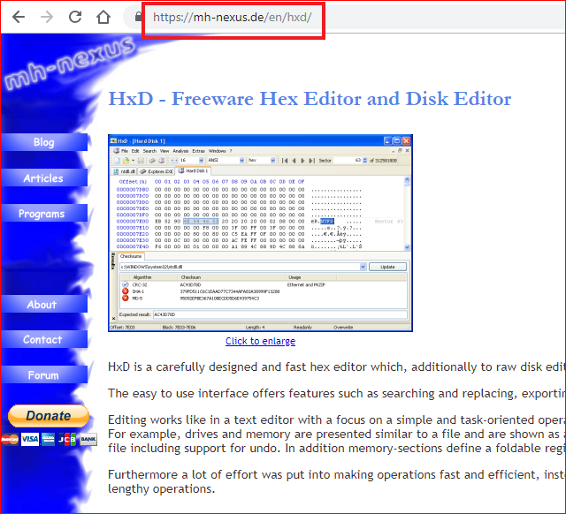
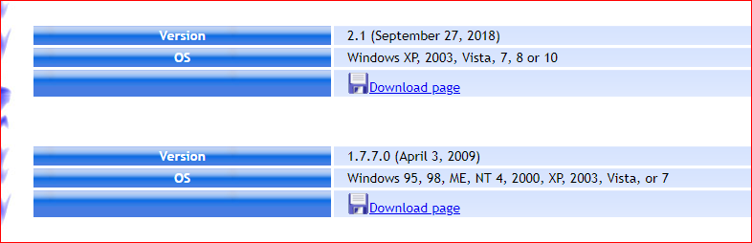
WinHex alternative (optional)
HxD - Freeware Hex Editor and Disk Editor

Slide 11
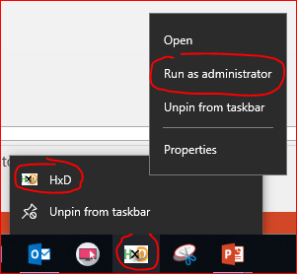
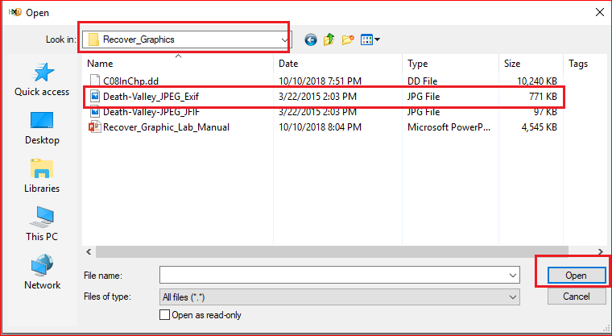
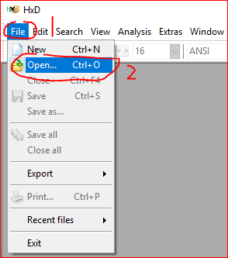

Slide 12
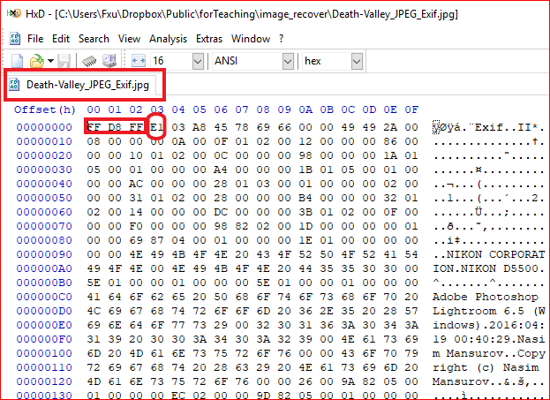
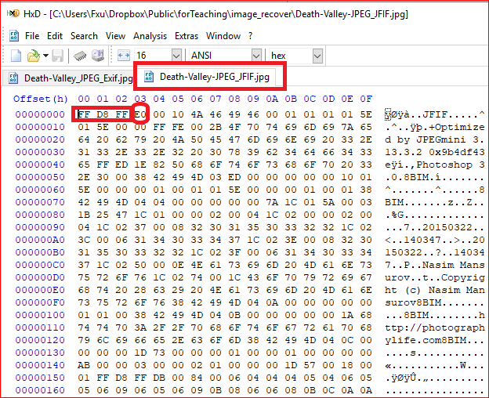

Slide 13
Repairing Damaged Headers

Slide 14
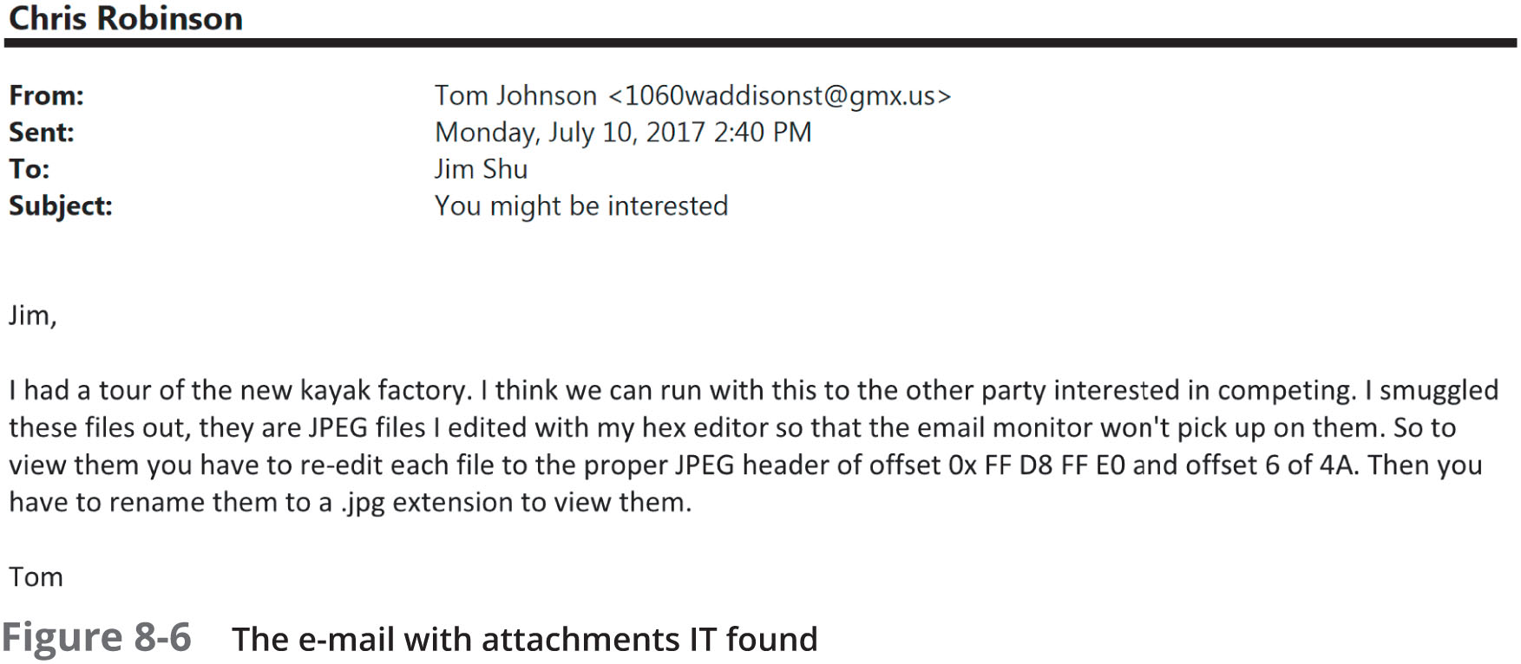
Case study
Investigate a possible intellectual property theft by a new employee of Superior Bicycles, Inc.

Slide 15
Understand the problem
“re-edit each file to the proper JPEG header of offset Ox FF D8 FF E0 and offset 6 of 4A”

Slide 16
Key Challenge
How to find these modified images?
We can research the string “FIF”

Slide 17
Key Challenge
How to find these modified images?
We can research the string “FIF”

Slide 18
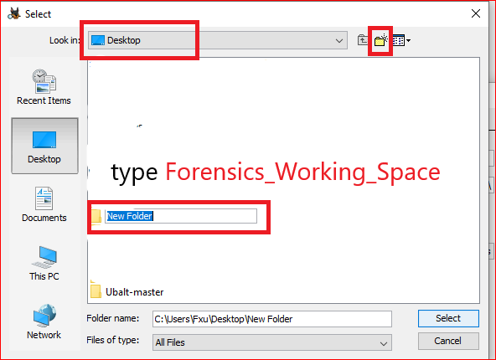
Create a working space

Slide 19
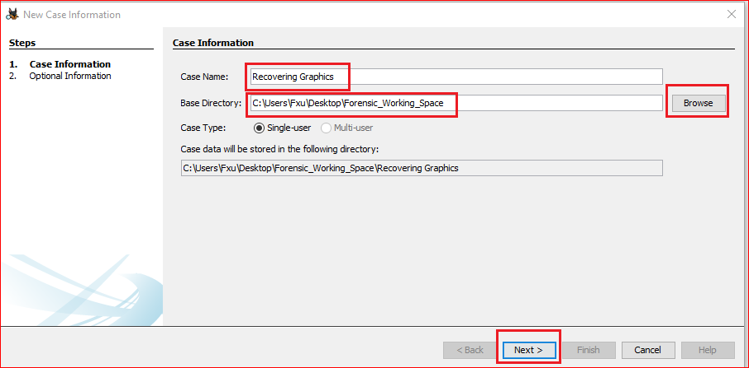
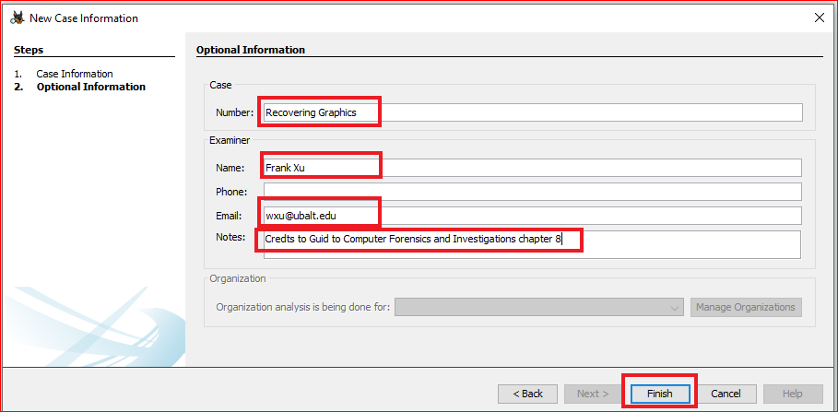

Slide 20
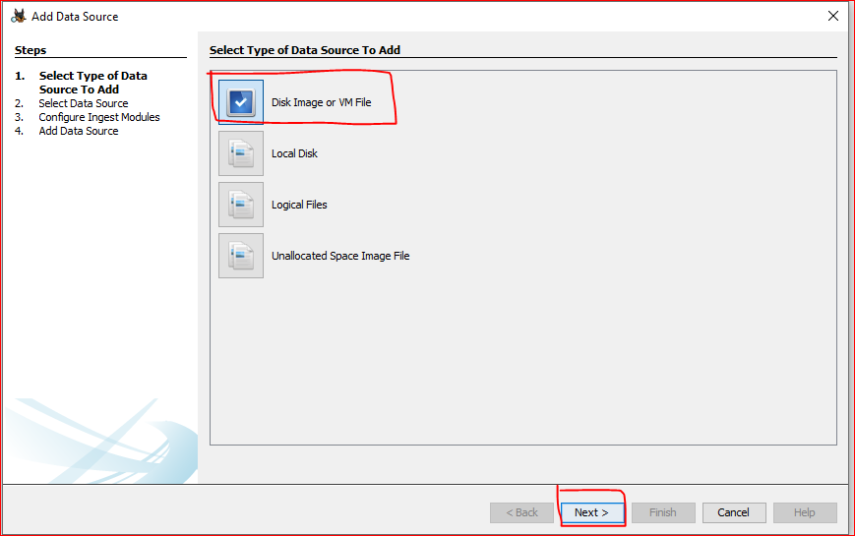
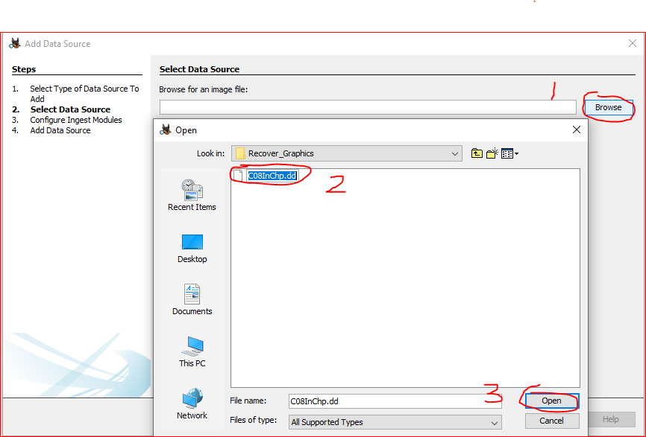

Slide 21
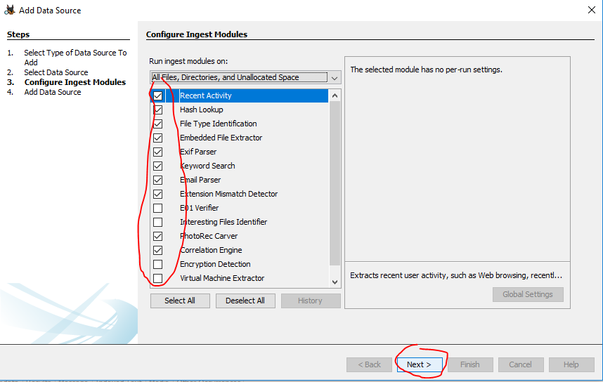

Slide 22
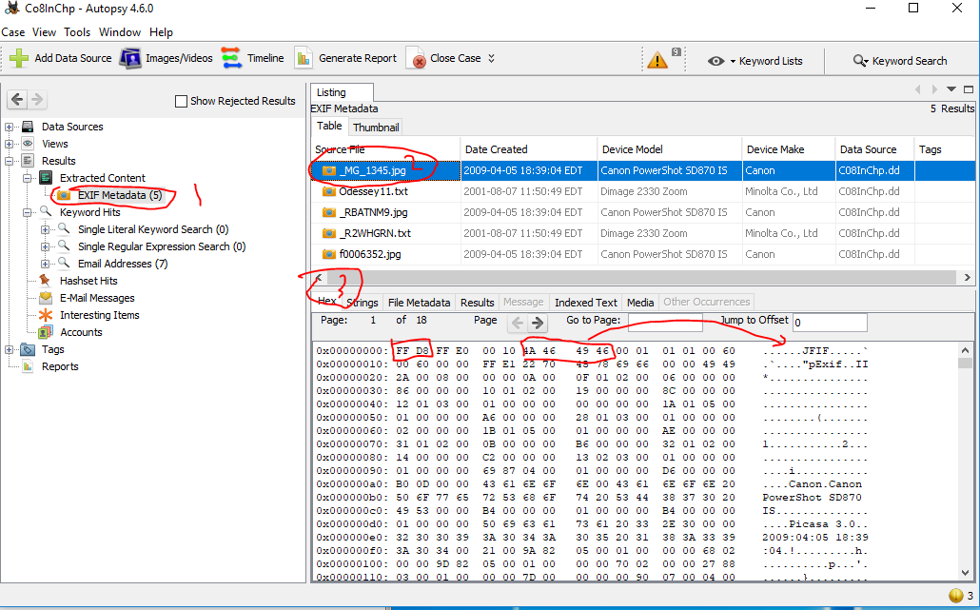

Slide 23
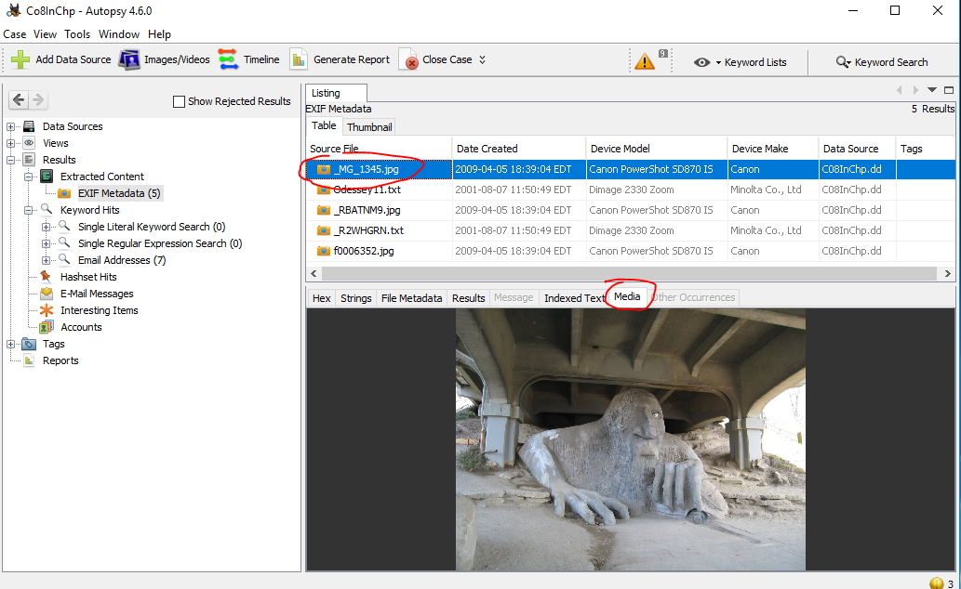

Slide 24
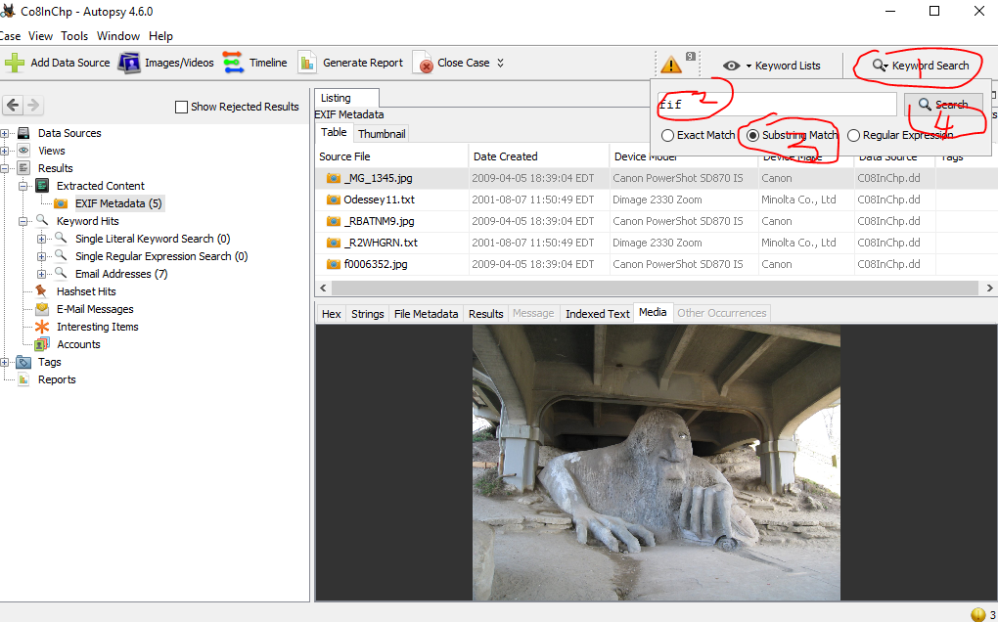
Search “FIF” substring

Slide 25
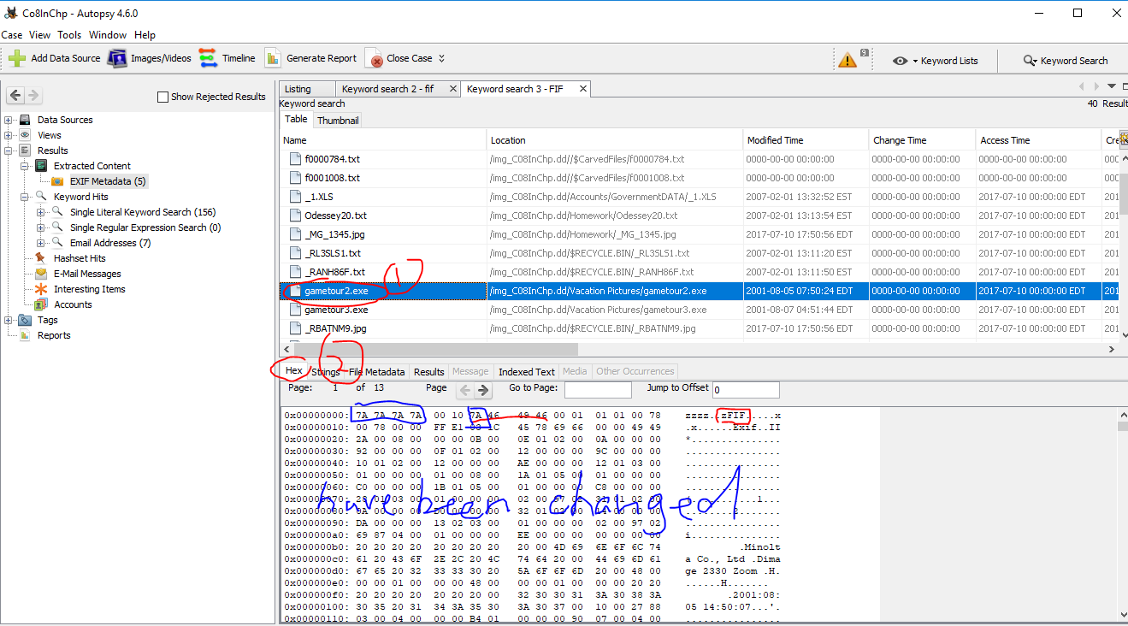

Slide 26
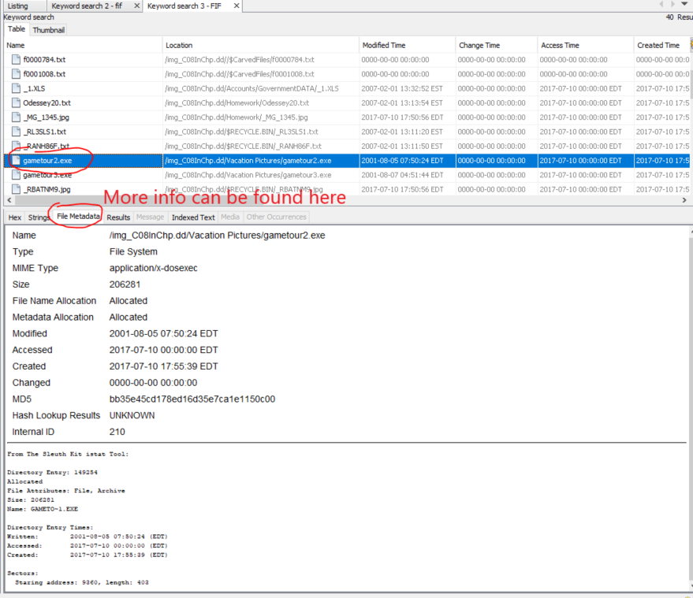

Slide 27
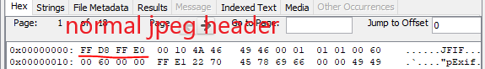
How to fix it?

Slide 28
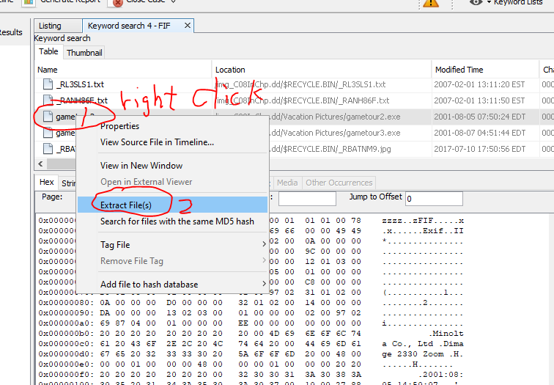
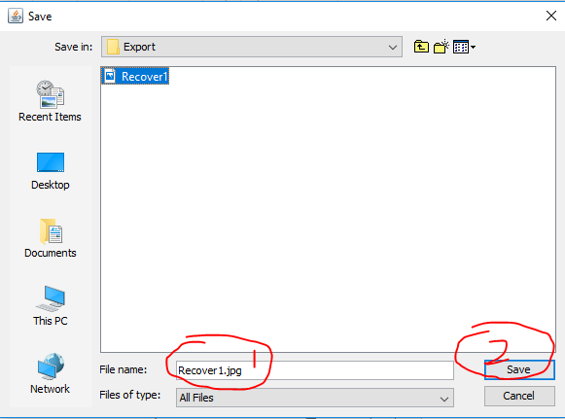
Extract the file

Slide 29
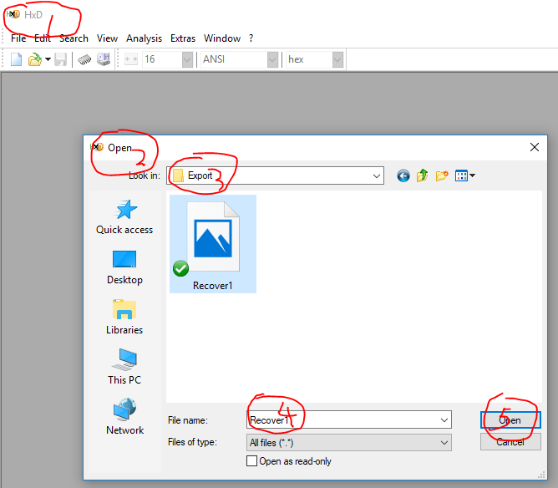
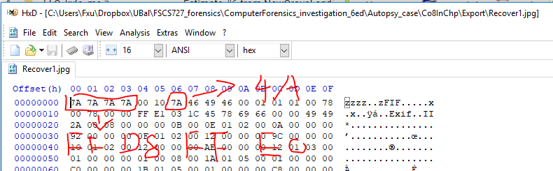
Review File headers
The correct header is highlighted

Slide 30
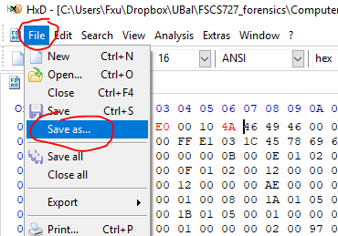
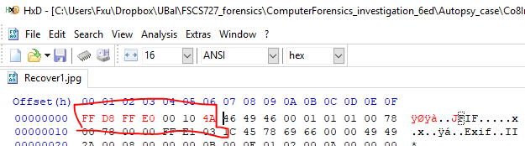
Rebuild File headers

Slide 31
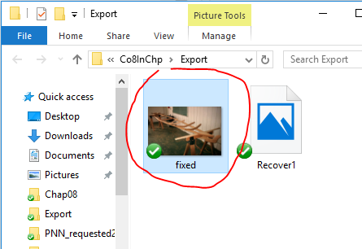
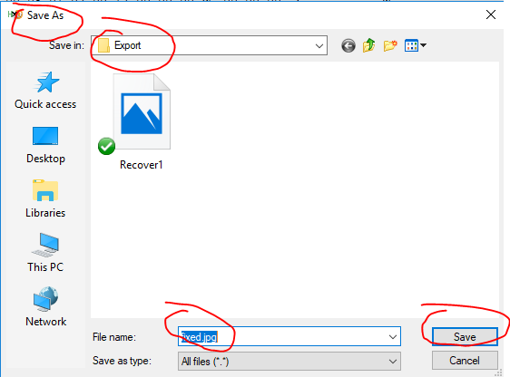
Rebuild File headers

Slide 32
Question?
Can you search and recover other pictures?

Slide 33
Find Magic numbers (file signatures)
Verify 5 file signatures using WinHex or HxD
http://technologieshare.com/what-is-exif-data

